Slide 1
Email Networks and Security
Networking 2, Day 2

Slide 2

Class Objectives
By the end of today’s class, you will be able to:
Validate DNS records using nslookup.
Describe the processes, protocols, and headers associated with email communication.
Analyze email headers to identify suspicious content.
2

Slide 3
DNS Record Types
3

Slide 4

Remember:
Domain Name Systems (DNS) is like the phonebook of the internet.
It’s why we can type www.google.com instead of 64.233.177.139.
4
Notes:
Image source: AdobeStock_262137712

Slide 5
Domain-to-IP-address is just one type of DNS translation.
5

Slide 6

DNS Record Types
DNS provides many details about a domain.
For example:
When you send an email to IT@acmecorp.com, your server must find the mail server name (mailhost.acmecorp.com) for the domain receiving the email.
The server checks that the mail record for acmecorp.com is mailhost.acmecorp.com.
6
Notes:
Image source: Conferno

Slide 7
DNS Zone File
All the records for a particular domain are stored in a file called the DNS zone file.
01
02
03
A DNS zone file lives in a DNS server.
DNS zone files contain a Time to Live (TTL), indicating how long a DNS cache will remember information in the file before having to request an updated copy.
DNS zone files also contain the DNS records with information about the domain.
7

Slide 8
DNS Record Types
Some common DNS record types include:
A Record: Translates a domain to an IP address. (widgets.com → 23.43.54.234)
PTR Record: Translates an IP address to a domain. (23.43.54.234 → widgets.com)
CNAME (canonical name) Record: An alias record used to point one domain to another domain. (widgets2.com → widgets.com)
SOA (state of authority) Record: Contains administrative details about a domain, such as the email of the administrator, TTL value, and time of last update.
NS (name server) Record: Indicates which server contains actual DNS records for a domain.
8

Slide 9
There are also DNS record types
that assist with email communication.
9

Slide 10


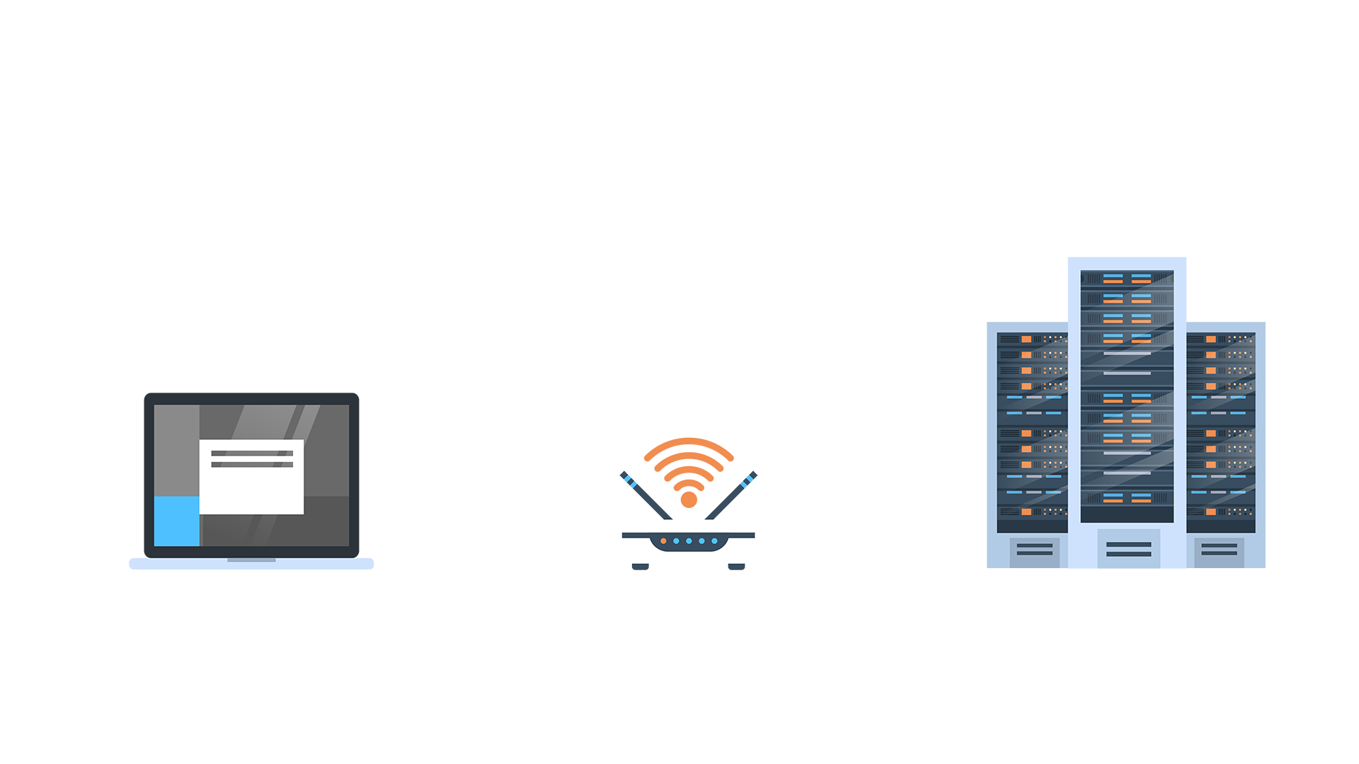
MX (Mail Exchange) Record
MX records directs emails to a specific mail server for a domain.
widgets.com has a mail server called mailhost.widgets.com.
If an email is sent to bob@widgets.com, the sender validates that the MX record for widgets.com is mailhost.widgets.com.
The sender directs the email to the mail server mailhost.widget.com.
✓
Widgets.com
@
@
Mail server: mailhost.widgets.com
10

Slide 11
MX Record
Just like NS Records, domains can have multiple MX records in case one goes down or can’t handle all the traffic.
Preference numbers set the primary and secondary mail servers.
For example: gadgets.com has the following MX records:
10 mailhost_Atlanta.gadgets.com
5 mailhost_NewYork.gadgets.com
20 mailhost_LA.gadgets.com
Emails sent to gadgets.com are first received by New York (5). If NY is down, Atlanta (10) will be tried next. If Atlanta is down, LA (20).
11

Slide 12
TXT (Text) Record
TXT Records are used to include notes related to the DNS.
Some notes are human-readable, such as the associated company name.
Other notes are read by the computer, such as the SPF (Sender Policy Framework), which determines if an email is from a trusted server.
12

Slide 13
SPF Record
Organizations might send emails from mail servers outside their domain.
Mail servers may exist in another domain, and outside companies often send marketing emails on behalf of an organization.
An SPF record indicates mail servers that can send emails on behalf of a domain to prevent spam, phishing, and email spoofing, by detecting emails that may have a forged sender email.
Example of an SPF record: v=spf1 ip4:192.41.100.193
v= is the version of SPF used.
ip4: indicates a IPv4 host is allowed to send emails.
192.41.100.193 is the IP allowed to send emails on behalf of the domain.
13

Slide 14
How SPF Works
widgets.com’s DNS SPF record indicates that 23.43.54.235 and 23.43.54.236 are the IP addresses of mail servers allowed to send emails on its behalf.
gadgets.com receives a suspicious email from a widgets.com email.
When the receiving email server at gadgets.com receives the email, it:
Checks the sending mail server's IP address, which is 12.54.54.23.
Validates the DNS record of widget.com’s SPF record to confirm the sending mail server's IP address is either 23.43.54.235 or 23.43.54.236.
The sender’s IP is 12.54.54.23,not 23.43.54.235 or 23.43.54.236. gadgets.com’s mail server can identify the email as spam and reject or send it to the spam folder.
14

Slide 15
nslookup
If emails are not reaching their final destination, we need to check that the MX DNS record for that particular domain is accurate.
nslookup (name server lookup) is a command-line tool that allows us to easily look up the DNS records of any domain.
15

Slide 16
nslookup
16

Slide 17
Activity: DNS Record Types
In this activity, you will continue to play the role of a security analyst for Acme Corp.
Acme Corp recently updated several domain DNS records. Your task is to use nslookup to validate the updates of the DNS records for each of the domains provided.
10 minutes
17

Slide 19
Introduction to Email Networking
19

Slide 20
An understanding of the processes and technologies involved in sending emails is key for security professionals, who have to manage email issues or attacks.
20

Slide 21
How Emails are Sent
21

Slide 22



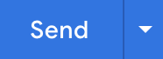
How Emails Work
Step 1: Bob uses Microsoft Outlook to type and send an email to Alice.
Bob, bob@bob.com, composes an email to Alice, at alice@alice.com.
Once Bob clicks Send, the email is forwarded to Bob’s company’s email server.
The email server is also referred to as the MTA (mail transfer agent).
To: Alice@alice.com
@
Bob@bob.com
Email Server
Alice@alice.com
22

Slide 23
How Emails Work
Step 2: Bob’s mail server finds Alice’s mail server.
Bob's mail server does a DNS lookup against alice.com to determine its mail server.
Bob's mail server gets this information from alice.com's MX record.
Bob@bob.com
Email Server
Alice@alice.com
Looking for alice.com
23

Slide 24
How Emails Work
Step 3: Bob's mail server forwards the email to Alice’s mail server.
Using SMTP (Simple Mail Transfer), Bob’s mail server sends the email to Alice’s mail server.
SMTP uses port 25 and is part of Layer 7: Application of the OSI model.
✓
@
Bob@bob.com
Email Server
Email Server
Alice@alice.com
24
Alice@alice.com

Slide 25

How Emails Work
Step 4: Alice pulls Bob’s email onto her local computer to read it.
Two Layer 7 protocols can be used to transfer the email to Alice’s local computer.
POP3 (Post Office Protocol)
IMAP (Internet Message Access Protocol)
When Alice logs in and checks her email from Bob, the POP3 mailbox doesn't keep a copy of the email.
Alice would not be able to log into another computer to view Bob's email, as it already has been downloaded from the mail server.
POP3 has a security benefit, as the email will not exist on a server the recipient doesn't control.
A copy of the email is kept on the server.
Even after Alice logs in and check her email from Bob, she can check it again from another computer.
IMAP has the benefit of preventing data from being lost, as it backs up emails on a server.
25

Slide 26
To complete the previous steps, emails use headers made up of specific fields.
26

Slide 27
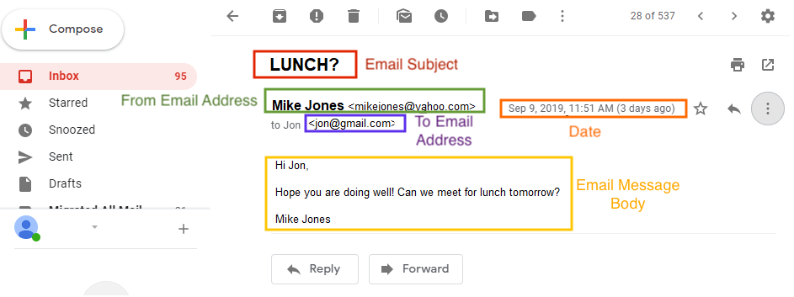
Familiar Fields
If you’ve ever sent an email, you’re probably familiar with the following fields:
27

Slide 28
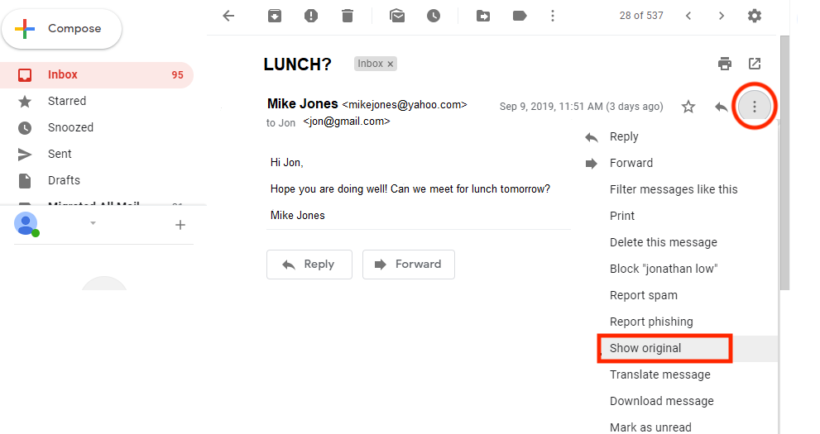
Unfamiliar Fields
More fields are revealed by viewing the complete raw email:
28

Slide 29
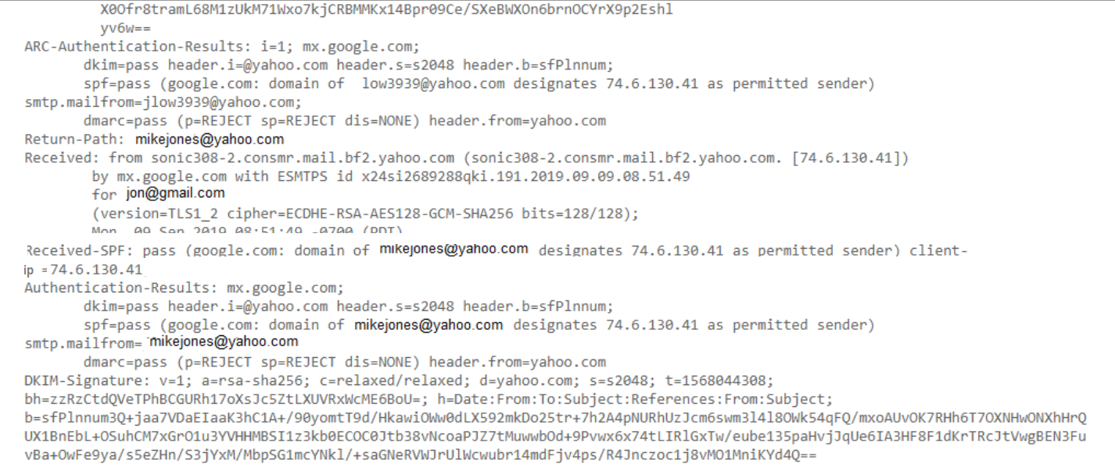
Unfamiliar Fields
The raw email will reveal other fields:
Return-Path: Specifies the sender's return email.
Return Path
29

Slide 30
Un-Familiar Fields
Received: Shows a list of the mail servers, illustrating the path of the email from source to destination.
Source IP
30

Slide 31
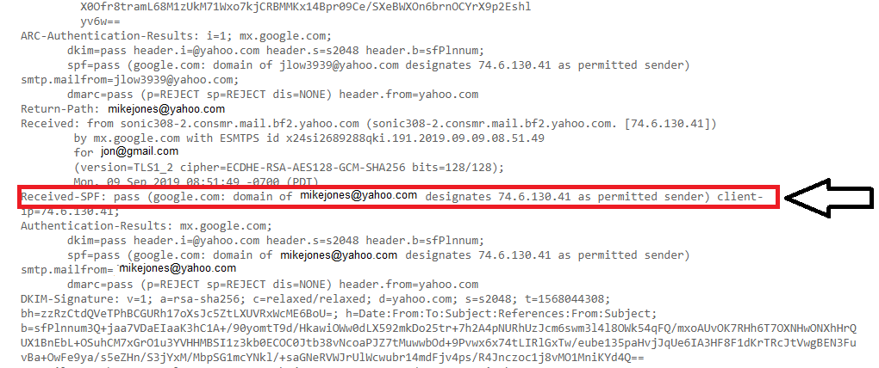
Unfamiliar Fields
Message-ID: Unique string created by the sending mail server as an identifier of the email.
Received SPF: The SPF verification field.
31

Slide 32
Activity: Email Networking
In this activity, you will continue to play the role of a security analyst for Acme Corp.
Your task is to analyze the header records of suspicious emails and document several data points.
15 minutes
32

Slide 34
Email Security Issue
34

Slide 35

Spam
Spam is the sending of unsolicited emails.
Spam is not inherently a security threat.
But reports state over 60% of all emails are spam. A large number of emails can be very inconvenient for organizations.
Many email systems have developed advanced methods for detecting and stopping spam emails.
These involve using SPF records, matching lists of known spam senders, and keyword identification.
35

Slide 36

Confidential Emails on Unencrypted Channels
Since emails are almost always unencrypted, there are risks of interception and unwanted viewing as they are routed across servers.
Several technologies can be used to encrypt confidential emails, such as PGP (Pretty Good Privacy) and S/MIME (Secure/Multipurpose Internet Mail Extensions).
36
Notes:
Image source: AdobeStock_292680742

Slide 37

Email Spoofing
Email spoofing is designing emails to trick the receiver into believing they’re coming from a trusted source.
Phishing—the attempt to gain sensitive information from an email recipient—is often accomplished through email spoofing. For example:
A scammer sends you an email pretending to be from your bank, asking you to update your username and password.
The email looks legitimate, but may contain a phishing URL leading to a fake bank login page that will capture your banking login info.
37
Notes:
Image source: shutterstock_1204626454

Slide 38

According to a recent report from Microsoft, phishing attacks are by far the most common cybersecurity threat— increasing a massive 250% since the previous report was published.
Source: CPO Magazine
38
Notes:
Image source: Ilya Kiselev

Slide 39
Email spoofing can be detected with several methods that analyze raw email headers in sent emails.
39

Slide 40

Method 1: the From Email Header
Spammers and phishers often disguise their true source email, changing the displayed email source to a name the recipient will trust or recognize.
In an email claiming to be from Citibank, you can view the raw email header and check the From or Return-Path field to display the true email address of the sender.
If the email address is sdfs2344dsf@yahoo.com, and doesn’t have an @citibank domain, this indicates a malicious email.
40
Notes:
Image source: shutterstock_1204626454

Slide 41
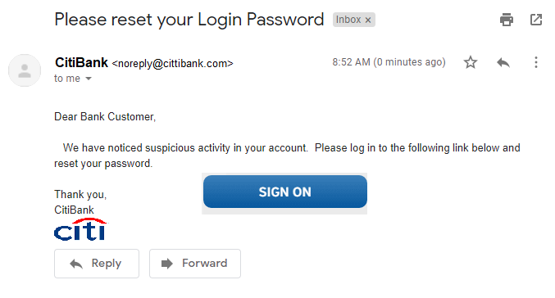
Method 1: the From Email Header
Spammers may also make slight changes to the sending domain name.
Notice anything off?
41

Slide 42
Method 1: the From Email Header
Spammers may also make slight changes to the sending domain name.
cittibank
42

Slide 43
Method 2: the Received-SPF Email Header
Remember: the SPF record is used to identify which mail servers are authorized to send emails on behalf of a domain.
Received-SPF is an email header that displays the results of validating the SPF record.
Received-SPF uses the IP address from the Received field and determines if it's an IP of an authorized sender.
If the IP is accepted it will display as a "pass." Received-SPF: pass (google.com: domain of michael@acme.com designates 76.87.4.15 as permitted sender
If the IP is not accepted it will display as a "fail."
Received-SPF: fail (google.com: domain of michael@acmers.com does not designate 174.81.74.11 as permitted sender)
43

Slide 44
Method 3: the Received Email Header
The Received header includes the source IP of the sending mail server.
For example: You receive an email from a US-based government organization, such as the IRS.
The IP address from the Received header record is 41.32.23.52.
When looking up this IP on a web tool like ARIN, the location of the IP is shown to be in Egypt.
This indicates that the email is probably not legitimate. It's unlikely a US government organization would have a mail server in Africa.
44

Slide 45
Activity: Email Security
In this activity, you will continue to play the role of a security analyst for Acme Corp.
You must further analyze the emails to determine which are spoofed and which are legitimate.
10 minutes
45

Slide 47


47
Notes:
Image source: AdobeStock_56885471

Slide 48
The remaining class time will be dedicated to reviewing networking and network security concepts covered in the past two units.
48

Slide 49
Activity: Networking Concepts Review
In this activity, you will review the most important topics of the past few classes: HTTP, ARP, DHCP, TCP and UDP, network devices, topologies, and routing, and network addressing.
15 minutes
49

Slide 51
Activity: Networking Attacks Review
In this activity, you will review ARP attacks, DHCP attacks, TCP attacks, wireless attacks, and email attacks.
15 Minutes
51

Slide 53
Class Objectives
By the end of today’s class, you will be able to:
Validate DNS records using nslookup.
Describe the processes, protocols, and headers associated with email communication.
Analyze email headers to identify suspicious content.
53

